Slide 1
The seminar on,
SEMANTIC WEB
Presented by,
Moumita Guha Roy
Roll No-99

Slide 2
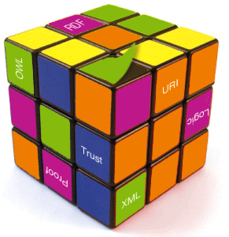
Content
What is internet & WWW.
Problems with today’s web.
Semantic web approach.
Aim of Semantic Web.
Component of semantic web.
Architecture of Semantic Web.
Application of semantic Web.
Conclusion.
References.

Slide 3

Let know first,
What is Internet?
What is web/WWW?

Slide 4

Problems with today’s web
Keyword based search engine
high recall
low recall
Results are highly sensitive to vocabulary
Results are single Web pages
Need human effort
Time consuming

Slide 5
What is semantic web approach?
The Semantic Web is a web that is able to describe things in a way that computers can understand.
Represent Web content in a form that is more easily machine-processable.

Slide 6
Aim of Semantic Web
Knowledge will be organized in conceptual spaces.
Automated tools will support maintenance.
Keyword-based search will be replaced by query answering:
Query answering over several documents will be supported.
Defining who may view certain parts of information (even parts of documents) will be possible.

Slide 7

Components of
Semantic Web Technologies
Explicit Metadata
Ontologies
Logic and Inference
Agent

Slide 8
(1)Metadata
Store data about data
Understand document’s meaning.

Slide 9
(2)Ontology
Ontology consists of a finite list of terms and provide a shared understanding of a domain.
Ontologies are useful for the organization and navigation of Web sites.
Also, ontologies are useful for improving the accuracy of Web searches.

Slide 10
(3)Logic & Inference
Logic provides formal languages for expressing knowledge.
An important advantage of logic is that it can provide explanations for conclusions
It is used by intelligent agent for making decision and selecting course of action.

Slide 11
(4)agent
Agents are pieces of software that work autonomously and proactively

Slide 12
Architecture of Semantic Web

Slide 13
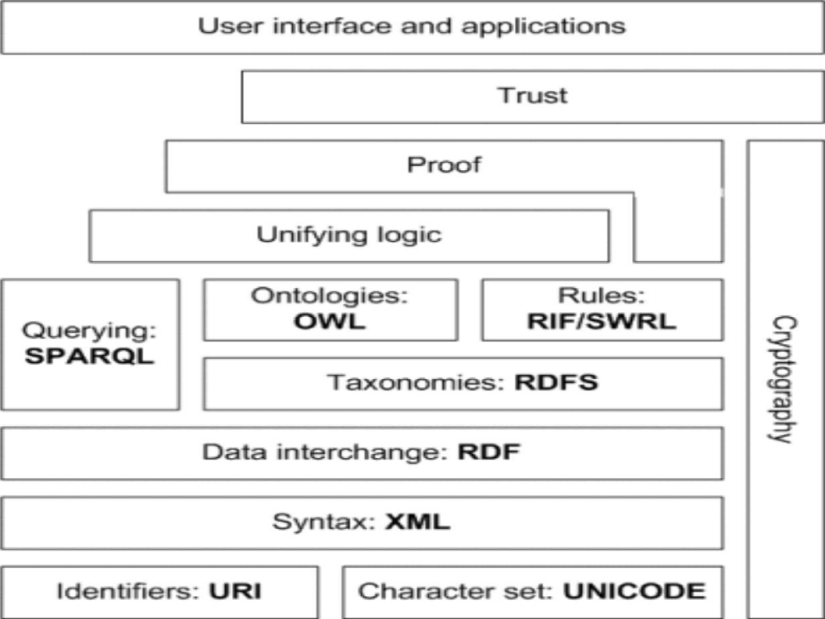

Slide 14
Application of Semantic Web
Web-services.
Semantics-based web search engines.
1) Large-scale robot-based search engines.
2) Small-scale reviewer-based search engines

Slide 15

Conclusion
Semantic web is a new technology
Many applications are experimental.

Slide 16
References
http://en.wikipedia.org/wiki/Semantic_Web
http://infomesh.net/2001/swintro/#whatIsSw
http://www.w3schools.com/semweb/default.asp
http://www.obitko.com/tutorials/ontologies-semantic-web/semantic-web.html
http://www.w3.org/DesignIssues/RDFnot.html
http://www.w3schools.com/semweb/semantic_example.asp
The.MIT.Press.Semantic.Web.Primer.2nd.Edition.Mar.2008.eBook-DDU.pdf

Slide 17
Questions?

Slide 18
Thank you

